Slide 1
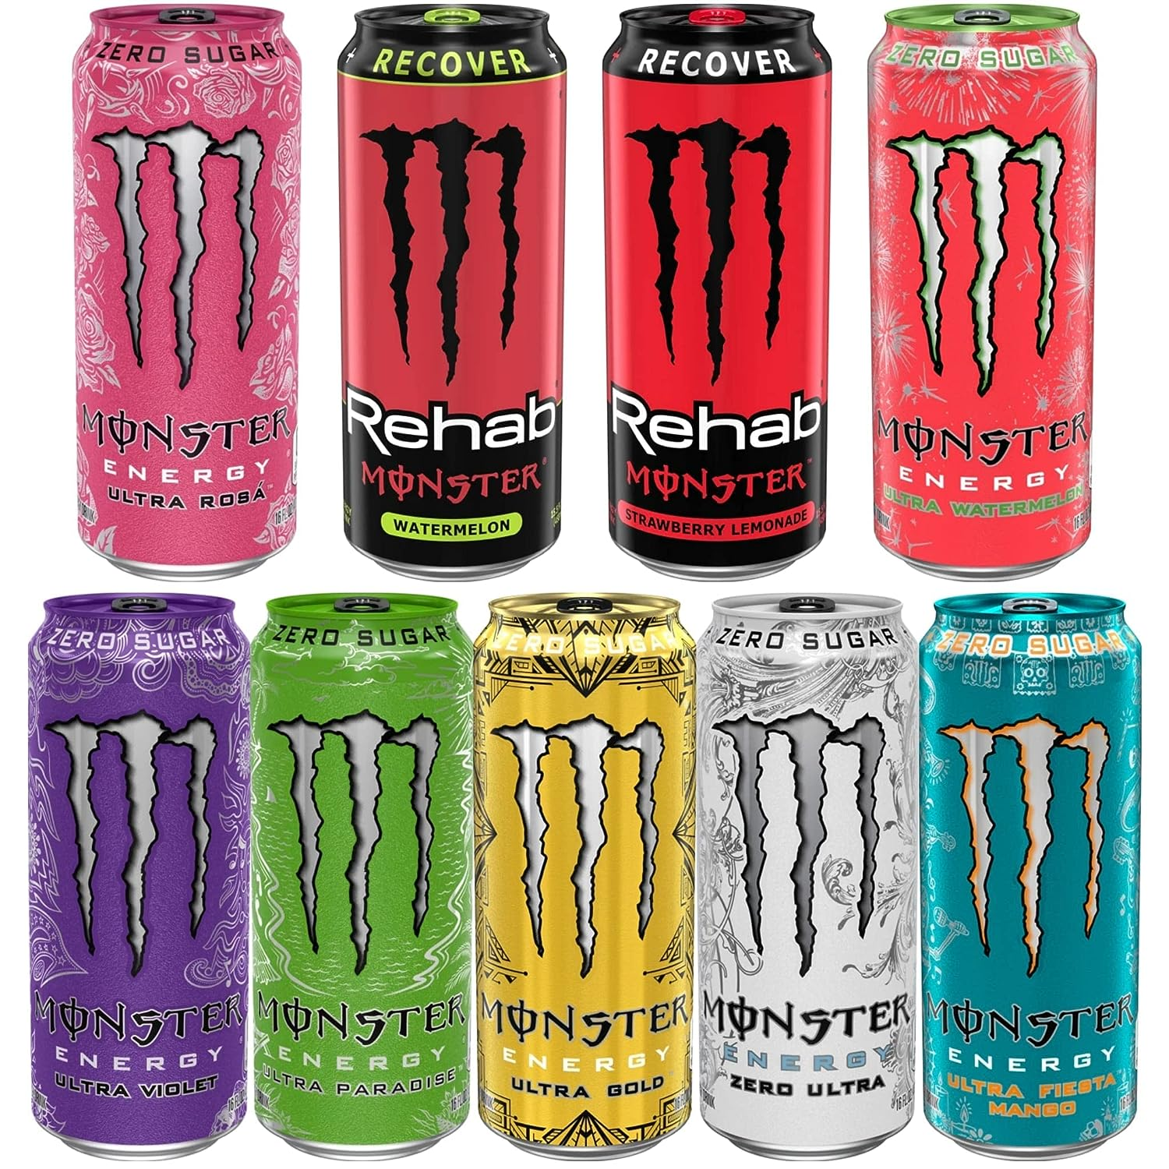
Provide insights to the marketing team in food & beverage industry

Slide 2

INsights
Introduction
Demographic Insights
Consumer Preferences
Competition Analysis
Product Development

Slide 3

introduction
Domain: F & B Function: Marketing
CodeX is a German beverage company that is aiming to make its mark in the Indian market. A few months ago, they launched their energy drink in 10 cities in India.
Their Marketing team is responsible for increasing brand awareness, market share, and product development. They conducted a survey in those 10 cities and received results from 10,000 respondents. Peter Pandey, a marketing data analyst is tasked to convert these survey results to meaningful insights which the team can use to drive actions.

Slide 4
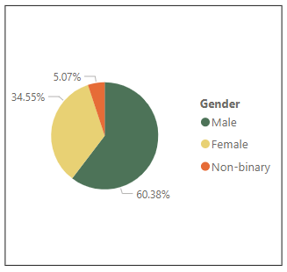
Demographic Insights
Out of 10 thousand respondents, the number of male respondents is 6,038.
This shows 60% of the consumers are male who prefer energy drinks more.

Slide 5
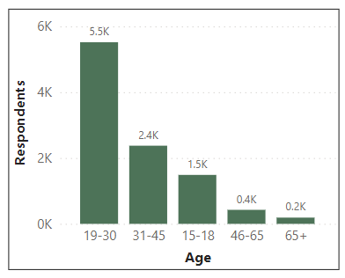
Demographic Insights
From the result of this survey, we get to know that energy drinks are more popular among youngsters. More than 50% of the respondents belong to the Age Group 19-30.
If we look at overall young age groups from 15 to 30, then the % will rise to 70%.

Slide 6
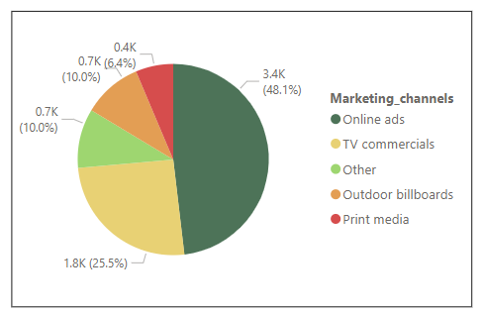
Demographic Insights
Online Ads are the most effective channel that reached 3,400 respondents.

Slide 7
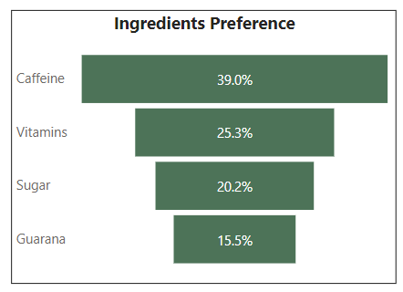
Consumer preference
As we know, caffeine increases attention and alertness, and it is often used in energy drinks. Caffeine is the most expected ingredient followed by the Vitamins in energy drinks.

Slide 8
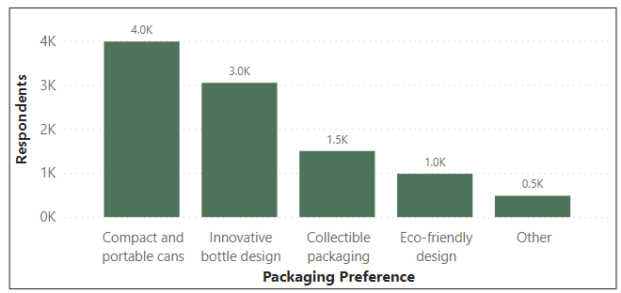
Consumer preference
Compact & Portable Cans are high in demand followed by Innovative Bottle Designs.

Slide 9
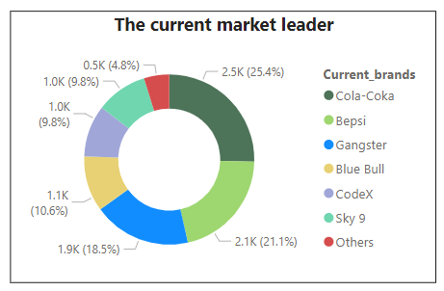
COMpetition analysis
Cola Coca is leading the market – 25% - followed by Pepsi – 21%. Our brand, 'CodeX,' holds a 9.8% market share, contributing to the competitive landscape.
The data shows there more respondents for Cola Coca than the other brands.

Slide 10
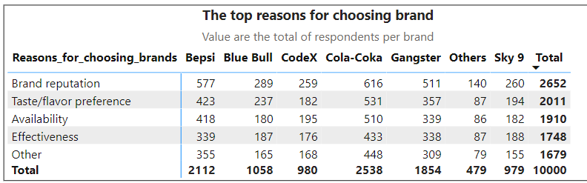
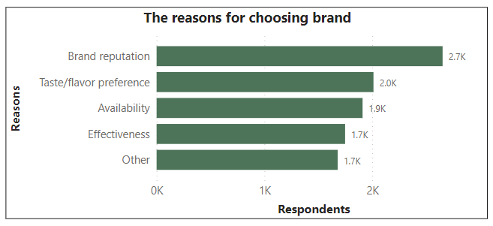
COMpetition analysis
Consumer preferences for energy drink brands are influenced by a range of factors. Among these, the top three reasons for favoring other brands include brand reputation, taste/flavor preference, and availability.
Brand reputation is also the primary reasons consumers prefer those brands over ours.

Slide 11
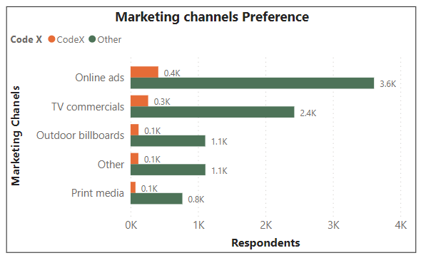
Marketing channels & Brand Awareness
As we have seen previously, Online Ads are the most effective way to reach maximum audiences in a short duration & it is cost effective as well, both with CodeX and other brands.

Slide 12
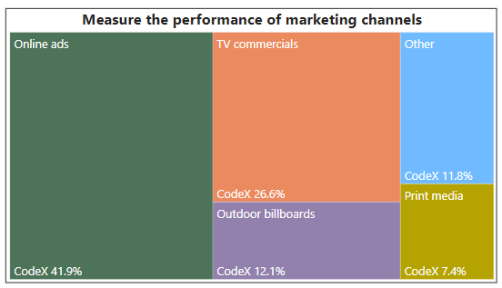
Marketing channels & Brand Awareness
As we have seen previously, Online Ads are the most effective way to reach maximum audiences in a short duration & it is cost effective as well, both with CodeX and other brands.
In CodeX, the effective performance of marketing channels as below order:
1/ Online ads – 42%
2/ TV commercials – 27%
3/ Outdoor billboards & Print media – 19%
4/ Other – 12%

Slide 13
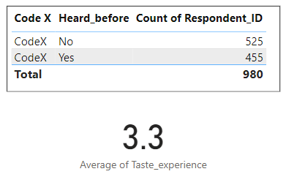
Brand Penetration
The data reveals a diverse range of opinions among consumers who have tried our product. Out of 980, 455 people have heard about our brand before, and 525 people have not.

Slide 14
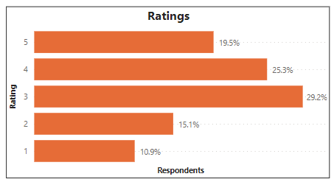
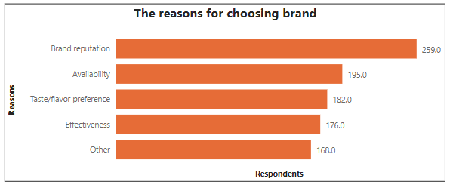
Brand Penetration
Taste ratings vary across categories, with 29.2% finding it average, 25.3% considering it good, and 19.5% labeling it excellent. It is good news. However, we need to address concerns - 10.9% rated it poor, and 15.1% rated it below average. Furthermore, among those who prefer our brand, factors such as brand reputation, availability, taste/flavor, and effectiveness stand out.

Slide 15
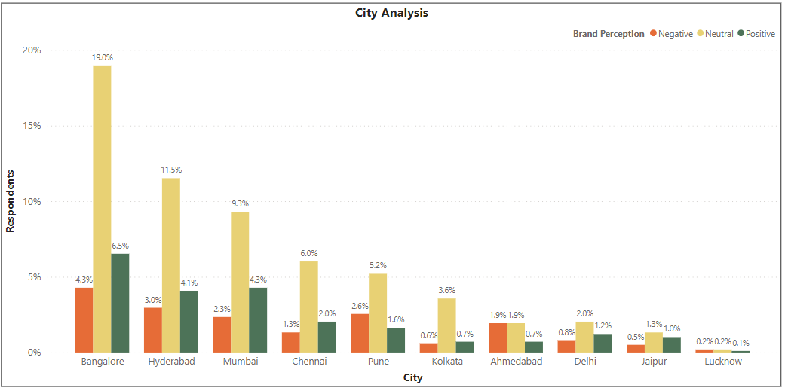
Brand Penetration
This Data shows people’s perception of CodeX as a brand in different cities.
The neutral and negative responses are combined in this visual as they both are greater in numbers than the positive responses. Hence improving the Positive response is one area where the marketing should focus on.

Slide 16
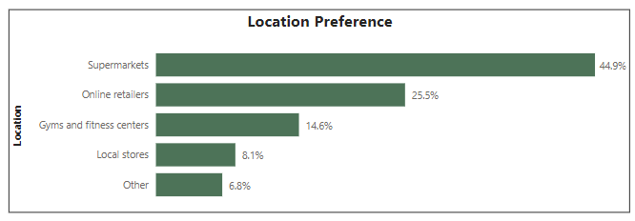
Purchase behavior
Supermarkets are the most common choice among consumers to buy energy drinks – account for 44.9% in total.
Besides, they also intend to buy them in online retails – 25.5%, gyms & fitness center – 14.6% and local stores – 8.1%

Slide 17
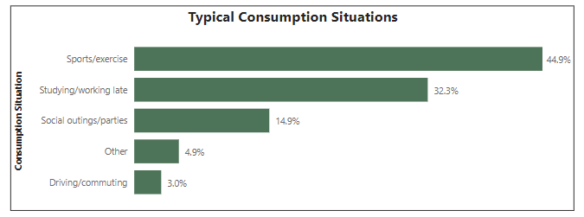
Purchase behavior
Sports/Exercises and Studying/Working late is the typical consumption situations for energy drink among respondents.

Slide 18
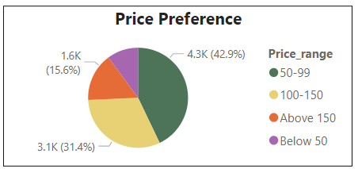
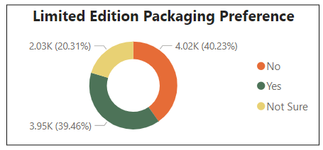
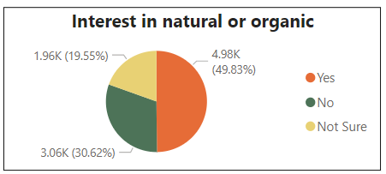
Purchase behavior
43% of the consumers buy a product if the price is between 50-99; 31% if the price is between 100-150 and the rest agreed with the higher price -> Leveraging this insight can guide targeted marketing efforts towards capturing varying preferences within the mid-tier price range.
40% of the consumers do not expect a change in the packaging while 39% of consumers are open to trying the Limited Edition Packaging.
Almost 50% of total respondents is interested in natural or organic.

Slide 19
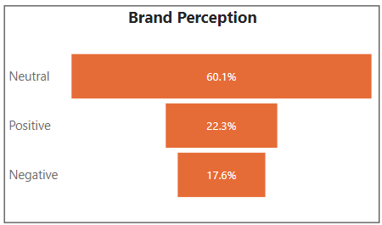
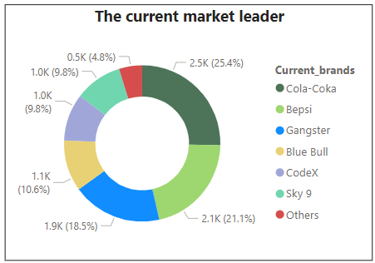
Product development
Brand Perception:
Positive perception about CodeX only accounts for 22.3% in total, it is a quite small number. Therefore, we need to change the negative group to positive group and minimize the negative group. As the result, our market share will be increase.

Slide 20
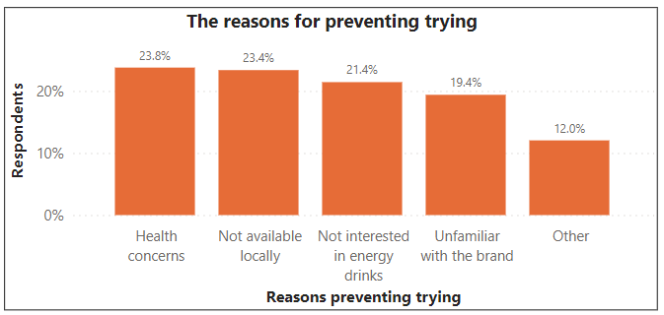
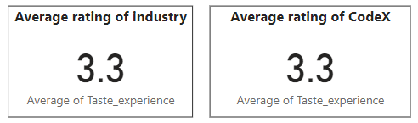
Product development
Taste Exeprience:
The taste experience rating is the same as the industry rating. This is not something that needs immediate attention.
Reasons preventing trying
Two reasons for not trying our product we must concern here are "Not available locally" and "Unfamiliar with the brand.“ -> Focusing on increasing availability and brand visibility can attract more customers. Ex: Online ads and TV commercials effectively reach potential customers.

Slide 21
RecomMendationS
What immediate improvements can we bring to the product?
What should be the ideal price of our product?
What kind of marketing campaigns, offers, and discounts we can run?
Who can be a brand ambassador, and why?
Who should be our target audience, and why?

Slide 22
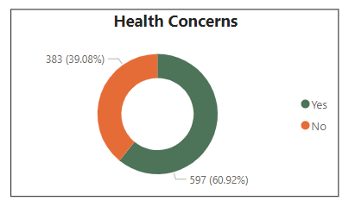
1. What immediate improvements can we bring to the product?
Health concerns:
Above 50% of people are concerned about the health problems that energy drinks bring them so we should add more natural ingredients, reduce sugar content to improve positive response rate.

Slide 23
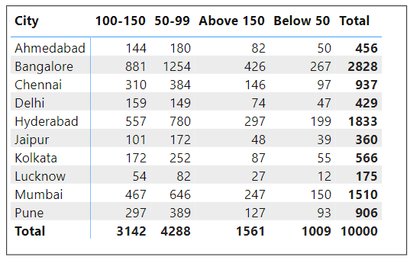
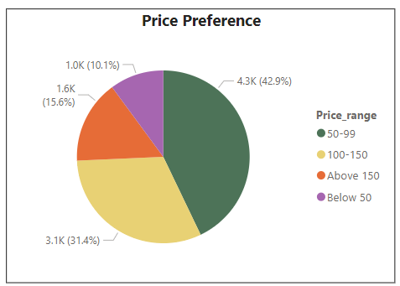
2. What should be the ideal price of our product?
The price range expected by consumers lies between 50 to 150. Some cities such as Bangalore, Hyderabad, Mumbai are willing to pay above 150.

Slide 24
3. What kind of marketing campaigns, offers, and discounts we can run?
Offers & Discounts:
In the previous recommendation, we saw that we can experiment with the price in different cities. Also, if changing the price does not go with the brand’s strategy, we can provide offers on buying the pack of 6 cans at a cheaper cost.
Also, each of these cities celebrates multiple festivals throughout the year. We can come up with the gift set packs.

Slide 25
3. What kind of marketing campaigns, offers, and discounts we can run?
Campaigns:
Social Media:
We have seen in the insights that our consumers fall in the age group of 15 to 30. This age group is very active on social media and they also get to know about the products from online ads. Running Social Media Ads can be a good strategy to reach them.
Influencer Marketing:
Influencer marketing can be very cheap we set a strategy to target influencers and their audiences.
We can collaborate with the influencers with the following of 10k to 100k, then 100k to 500k, and so on.
Introducing our products to consumers via influencers can help in changing brand perception.

Slide 26
3. What kind of marketing campaigns, offers, and discounts we can run?
Campaigns:
Online Retailers/E-commerce:
E-commerce and online grocery store do have their own PPC platforms. We can run paid ads on these platforms to increase the sale of the product because we are still not as well known by the consumers as the other brands.
Guerilla Marketing:
Consumers are buying products from supermarkets – We need to do some kind of special displays in supermarkets like renting and setting up a counter, or paying supermarkets for a space to display our products exclusively.
We can do some creative campaigns in some food festival events to attract consumers and provide free testers to get more feedback on tasting to get reasonable insights.

Slide 27
4. Who can be a brand ambassador, and why?
While choosing the influencers, we need to keep in mind that we have to consider certain factors in mind.
Budget: Celebrity influencers charge more money according to their following and impact on social media.
Relevancy: Energy drinks are consumed by consumers who like to do some sort of physical activity. So, the celebrity should be a sportsperson, athlete or person indulged in some physical activity.
Impact: It is important to have an impact on their followers. Not every celebrity is influential but can still be followed by a vast audience. A celebrity who can influence the buying decision needs to be our brand ambassador.

Slide 28
5. Who should be our target audience, and why?
It is evident from the statistics that our consumers are mostly between the ages of 15 to 30.
From this survey, the count shows that 70% of consumers are youth.

Slide 29
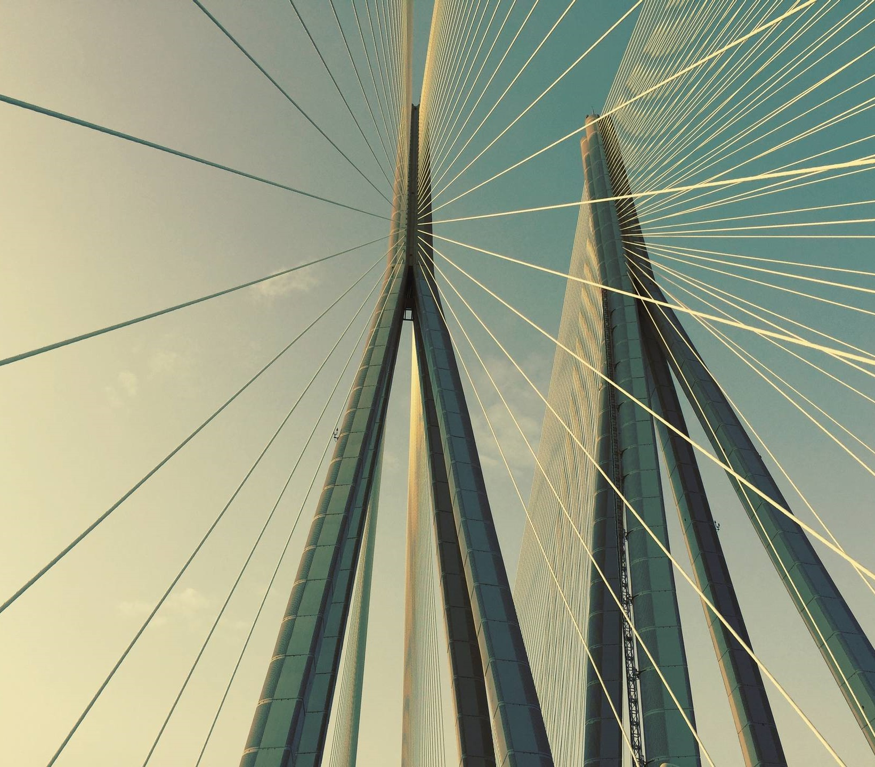
THANK YOU
Ho Nhu Quynh
quynhho0409@gmail.com

